Slide 1
CONTRACT MONTHLY CLAIM SYSTEM
HR Dashboard Automation
PORTFOLIO OF EVIDENCE
Olebogeng Phawe
ST10345327
21 November 2025

Slide 2
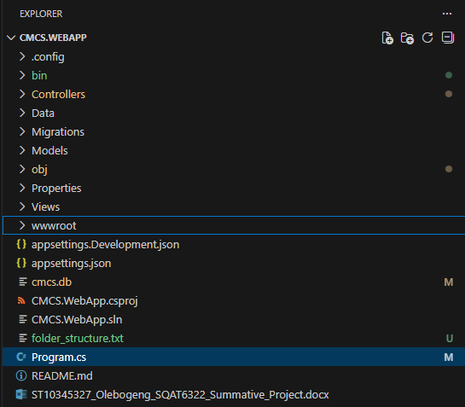
PROJECT OVERVIEW
ASP.NET Core MVC Web Application
Contract Monthly Claim Management System
Role-Based Accss Control
Automated HR Dashboard with Analytics
SQLite Database with Entity Framework
Dark/Light Mode Toggle

Slide 3
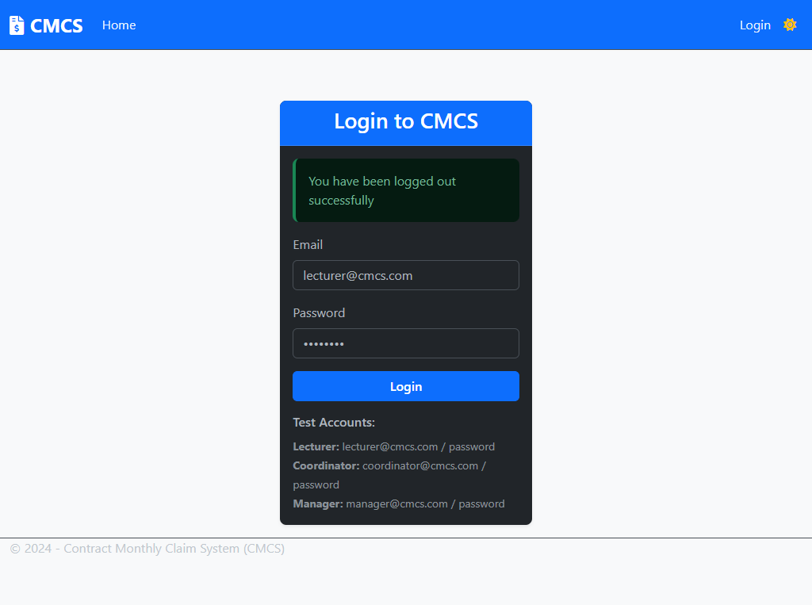

Slide 4
TECHNICAL ARCHITECTURE
Frontend:
ASP.NET Core MVC
Bootstrap 5 - Responsive UI
Chart.js - Data Visualization
JavaScript/jQuery - Client-side Logic
Backend:
• C# with Entity Framework Core
• SQLite Database
• Session-based Authentication
• ClosedXML - Excel Export

Slide 5

SECURE AUTHENTICATION SYSTEM
Session Management
Password Security
Authorization Filters
Role-based Access Control:
Lecturer: Submit & View Claims
Coordinator: Review & Approve Claims
Manager/HR: Full Dashboard Access

Slide 6
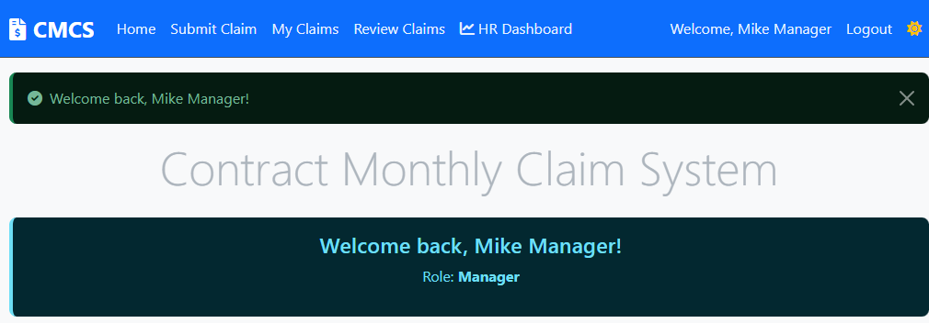
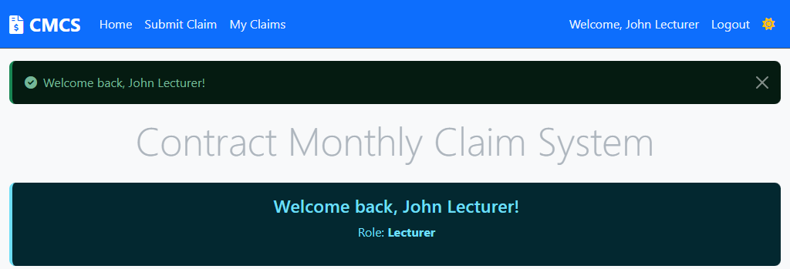
DIFFERENT USER DASHBOARDS
Manager Home Page (Mike)
Lecturer Home Page (John)

Slide 7
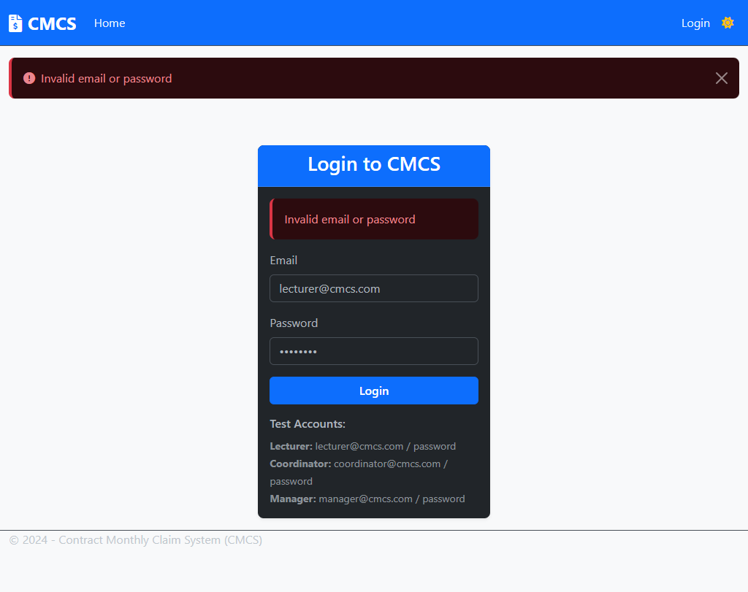

Slide 8
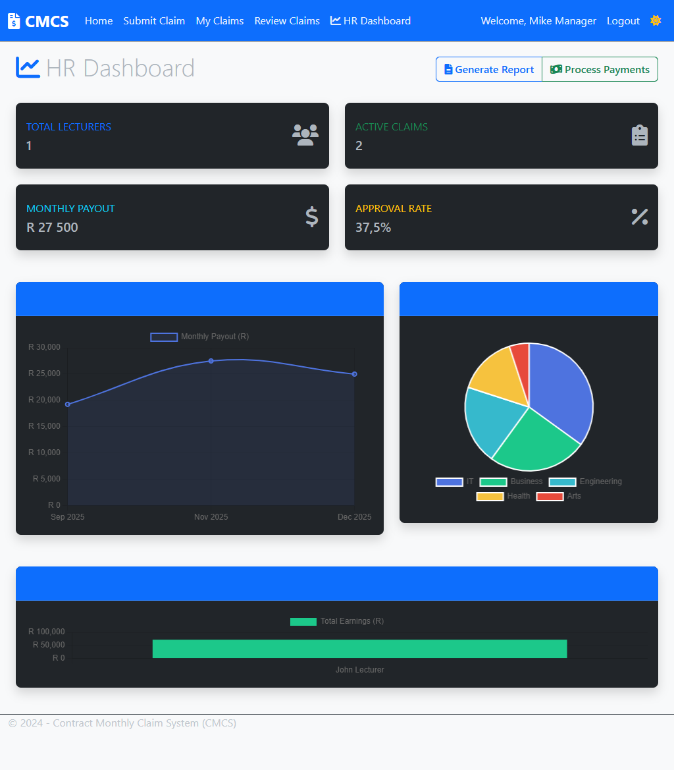
HR DASHBOARD AUTOMATION
Interactive Data Visualization
Real-time Analytics & Statistics
Automated Report Generation
Excel Export Functionality
Payment Processing Simulation
Role-based Access Control

Slide 9
DATA VISUALIZATION
Monthly Trends Chart:
• Line chart showing payout trends
• 6-month historical data
• Real-time data aggregation
Department Spending:
• Pie chart breakdown
• Visual department comparison
• Percentage distribution
Lecturer Performance:
• Bar chart ranking
• Top 8 performers
• Earnings comparison

Slide 11
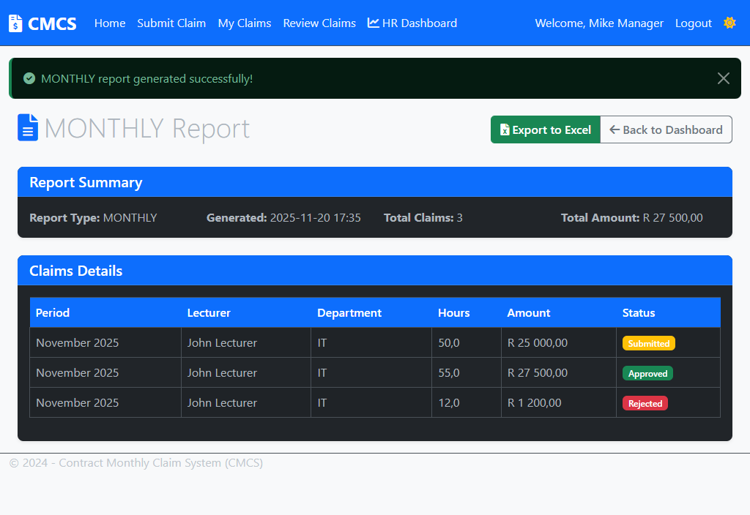
AUTOMATED REPORTING
Report Types:
• Monthly Reports - Current month claims
• Pending Reports - Awaiting approval
• Custom filtering and sorting
Features:
• Summary statistics
• Detailed claims listing
• Status tracking
• Export capabilities

Slide 12
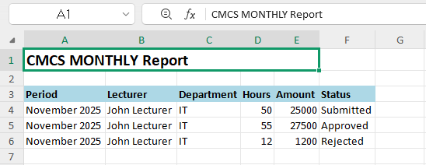
EXCEL EXPORT FUNCTIONALITY
Automated Excel file generation
Professional formatting
Branded headers and styling
Auto-fit columns
Multiple report types supported
Benefits:
Reduced manual work
Standardized reporting
Easy data sharing
Professional presentation

Slide 13
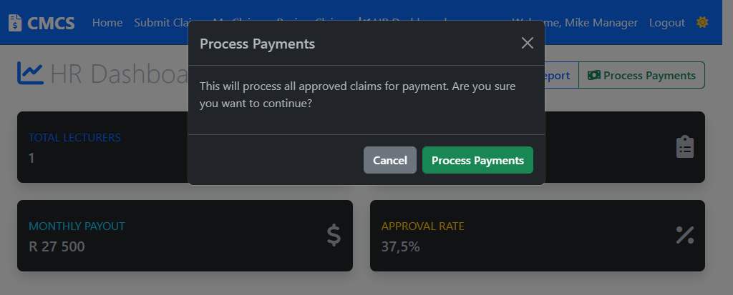
PAYMENT PROCESSING SIMULATION
Batch processing of approved claims
Automated status updates
Audit trail with processor info
Success/error handling
Real-time notifications
Workflow:
1. Filter approved claims
2. Process in batch
3. Update status and dates
4. Generate confirmation

Slide 14
AUTOMATION BENEFITS
Time Savings:
• Reduced manual data processing
• Automated calculations
• Streamlined workflows
Accuracy:
• Error-free computations
• Consistent reporting
• Data validation
Decision Making:
• Real-time analytics
• Visual data representation
• Historical trends

Slide 15
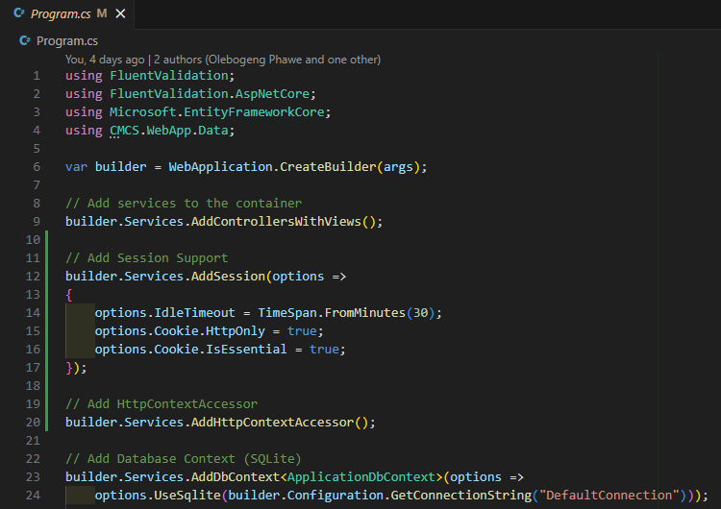
CODE QUALITY & BEST PRACTICES
Clean Architecture & MVC Pattern
Entity Framework Code-First
Comprehensive Error Handling
SQLite Compatibility
Responsive Design Principles
Git Version Control (12+ commits)

Slide 16
TECHNICAL CHALLENGES SOLVED
SQLite Decimal Aggregation:
• Fixed decimal computation issues
• Implemented client-side grouping
• Maintained data accuracy
Chart Data Integration:
• Real-time data binding
• Dynamic chart updates
• Performance optimization
Role-based Security:
• Secure session management
• Proper authorization filters
• Access control implementation

Slide 17
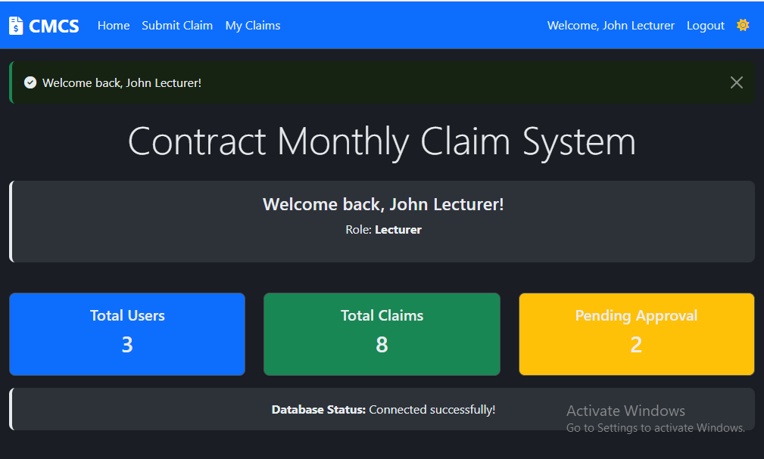
USER EXPERIENCE DESIGN
Responsive Design:
• Mobile-friendly interface
• Bootstrap grid system
• Adaptive components
Professional Styling:
• Consistent color scheme
(Dark Mode Toggle)
• Intuitive navigation
• Accessible design
Interaction Design:
• Smooth animations
• Clear feedback messages
• Logical workflow

Slide 18
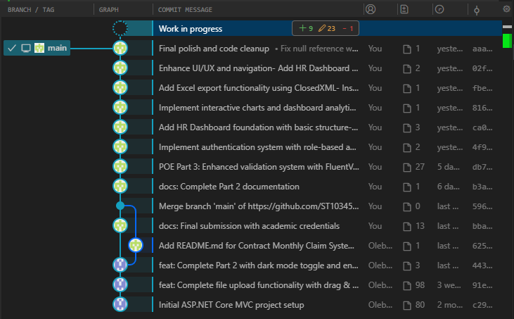
IMPLEMENTATION EVIDENCE
GitHub Repository:
• 12+ descriptive commits
• School credentials (ST10345327)
• Clean code structure
• Comprehensive documentation
Technical Validation:
• Builds with 0 errors, 0 warnings
• All features functional
• Cross-browser compatible
• Database operations working

Slide 19
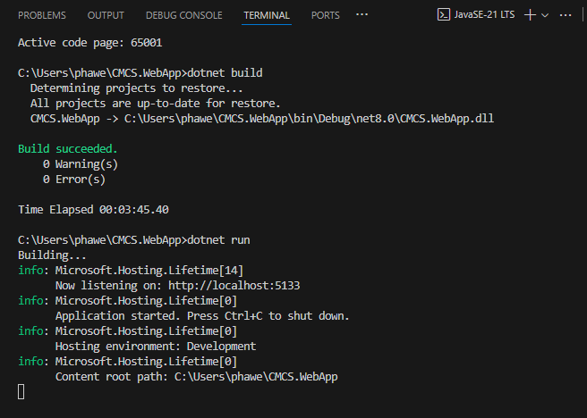

Slide 20
CONCLUSION
DEMONSTRATION:
• Live application demo
• All features functional
• Ready for deployment
Thank You!

